Slide 1
Chapter 15 Error Detection and Hamming Code

Slide 2
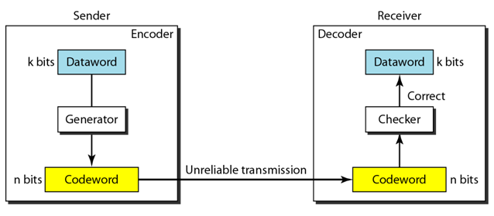
Introduction
Error can be handled in two ways:
Receiver can have the sender retransmit the entire data unit.
The receiver can use an error-correcting code, which automatically corrects certain errors. (Forward error correction (FEC).

Slide 3
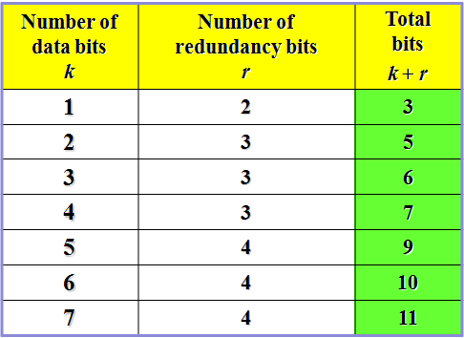
Forward Error Correction
Consider only a single-bit error in k bits of data
  k possibilities for an error
  One possibility for no error
  possibilities = k + 1
Add r redundant bits to distinguish these possibilities; we need 2^{r} ≥ k+1
But the r bits are also transmitted along with data; hence
2^{r} ≥ k+r+1

Slide 4
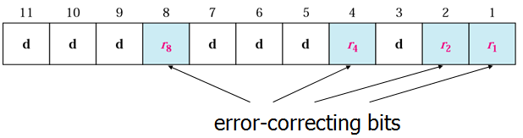
Hamming Code
Simple, powerful FEC
Widely used in computer memory

Slide 5
Hamming Code-general algorithm
The Hamming Code is simply the use of extra parity bits to allow the identification of an error.
Write the bit positions starting from 1 in binary form (01, 10, 11, etc).
All the bit positions that are a power of 2 are marked as parity bits (1, 2, 4, 8, etc).
All the other bit positions are marked as data bits.
Each data bit is included in a unique set of parity bits, as determined its bit position in binary form.
Parity bit 1 covers all the bits positions whose binary representation includes a 1 in the least significant.
position (1, 3, 5, 7, 9, 11, etc).

Slide 6
Hamming Code-general algorithm
Parity bit 2 covers all the bits positions whose binary representation includes a 1 in the second position from the least significant bit (2, 3, 6, 7, 10, 11, etc).
Parity bit 4 covers all the bits positions whose binary representation includes a 1 in the third position from the least significant bit (4–7, 12–15, 20–23, etc).
Parity bit 8 covers all the bits positions whose binary representation includes a 1 in the fourth position from
the least significant bit bits (8–15, 24–31, 40–47, etc).
Since we check for even parity set a parity bit to 1 if the total number of ones in the positions it checks is
odd.
Set a parity bit to 0 if the total number of ones in the positions it checks is even.

Slide 7
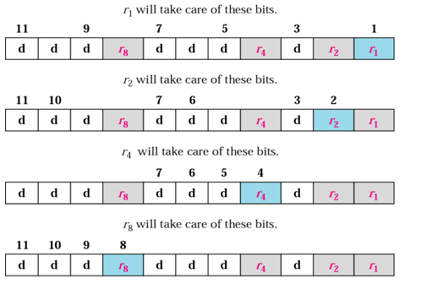
Redundant Bit Calculation

Slide 8
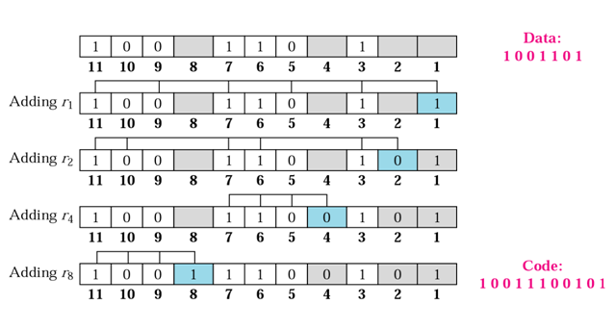
Redundant Bit Calculation

Slide 9
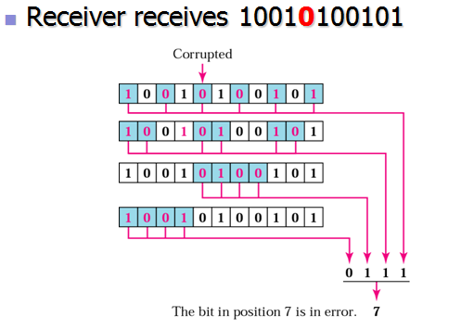
Redundant Bit Calculation

